Slide 1
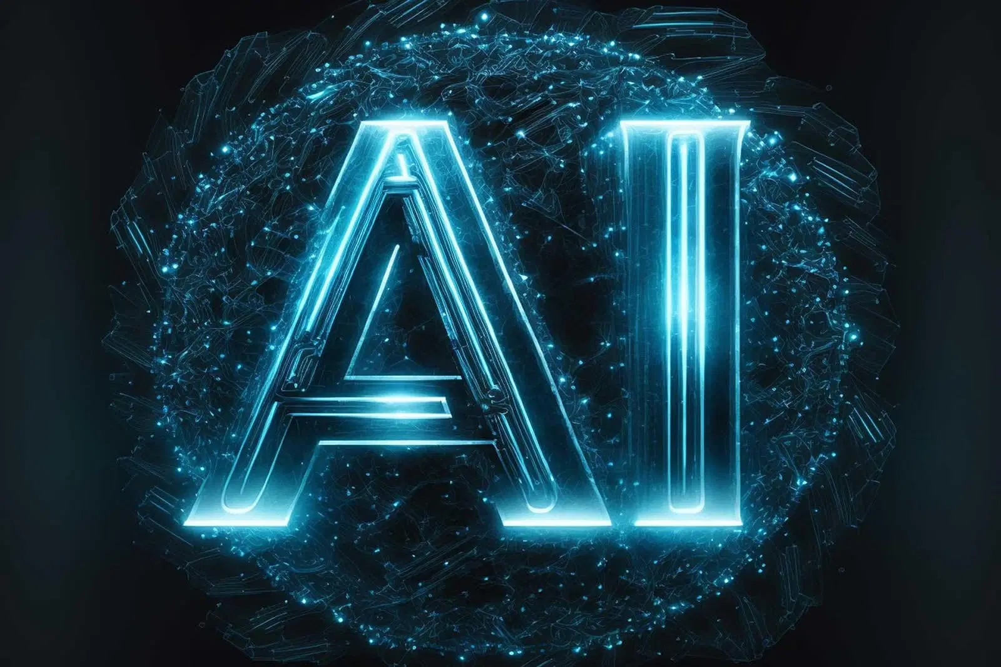
TITLE: Artificial Intelligence -Shaping the Future
Subtitle: Understanding the Basics, Applications, and Challenges
NAME: SWEETY AKTHAR MIM
Date: 18 JULY 2025

Slide 2
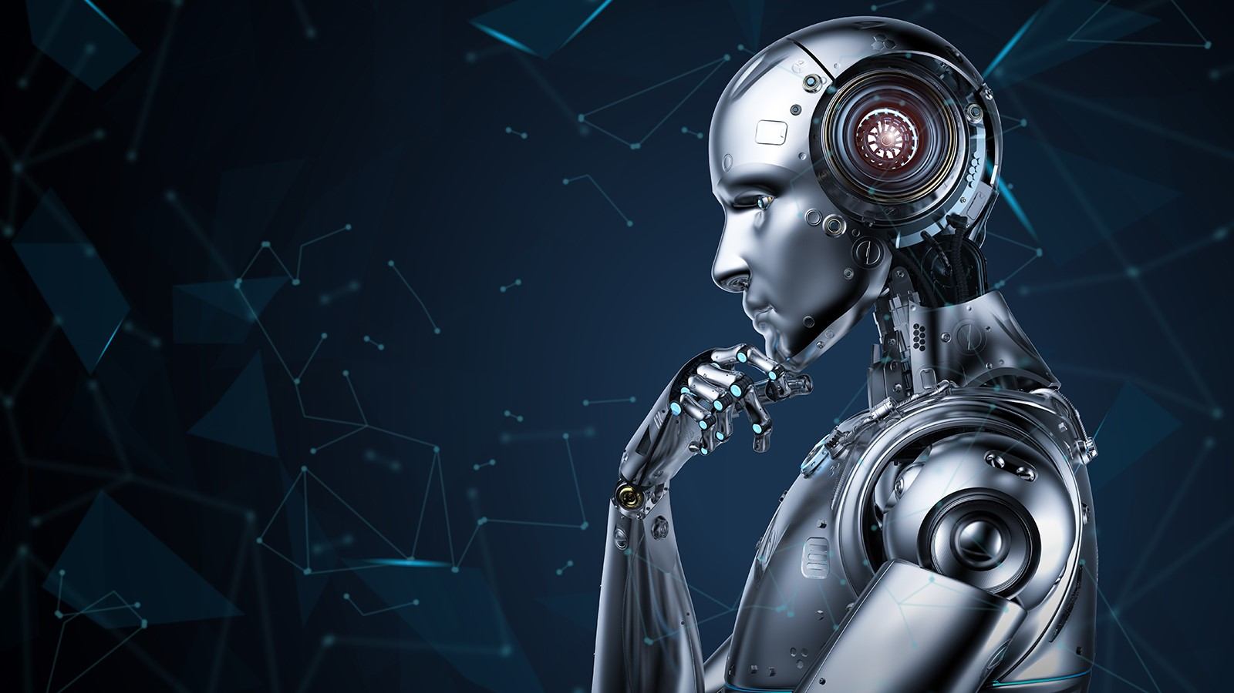
What is Artificial Intelligence?
AI refers to machines mimicking human intelligence.
Includes learning, reasoning, problem-solving, and language understanding.
Two main types:
Narrow AI: Specialized in one task.
General AI: Human-level intelligence across many tasks (still theoretical).
Presenter Note: Highlight examples like Siri (narrow AI) and the idea of AI in movies (general AI).

Slide 3
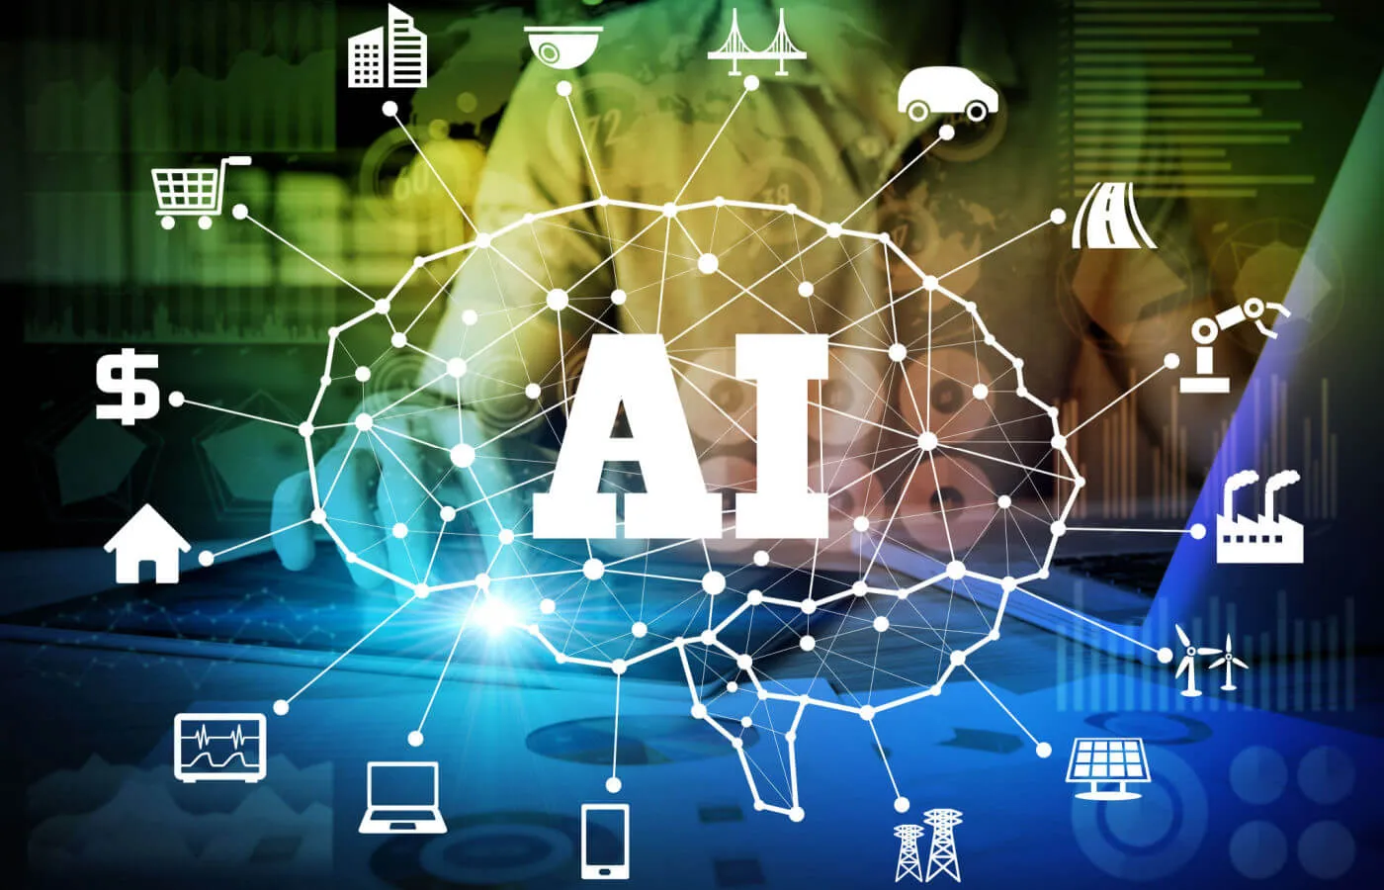
History of AI
1950s: Alan Turing and the Turing Test.
1956: Term “Artificial Intelligence” coined at Dartmouth Conference.
1997: IBM’s Deep Blue beats world chess champion.
2010s–2020s: Rapid progress with deep learning and AI tools like ChatGPT.
How AI Works
Machine Learning: Training machines using data.
Neural Networks: Mimicking human brain structure.
Deep Learning: Advanced neural networks for complex tasks.
Natural Language Processing (NLP): Understanding and generating human language.

Slide 4
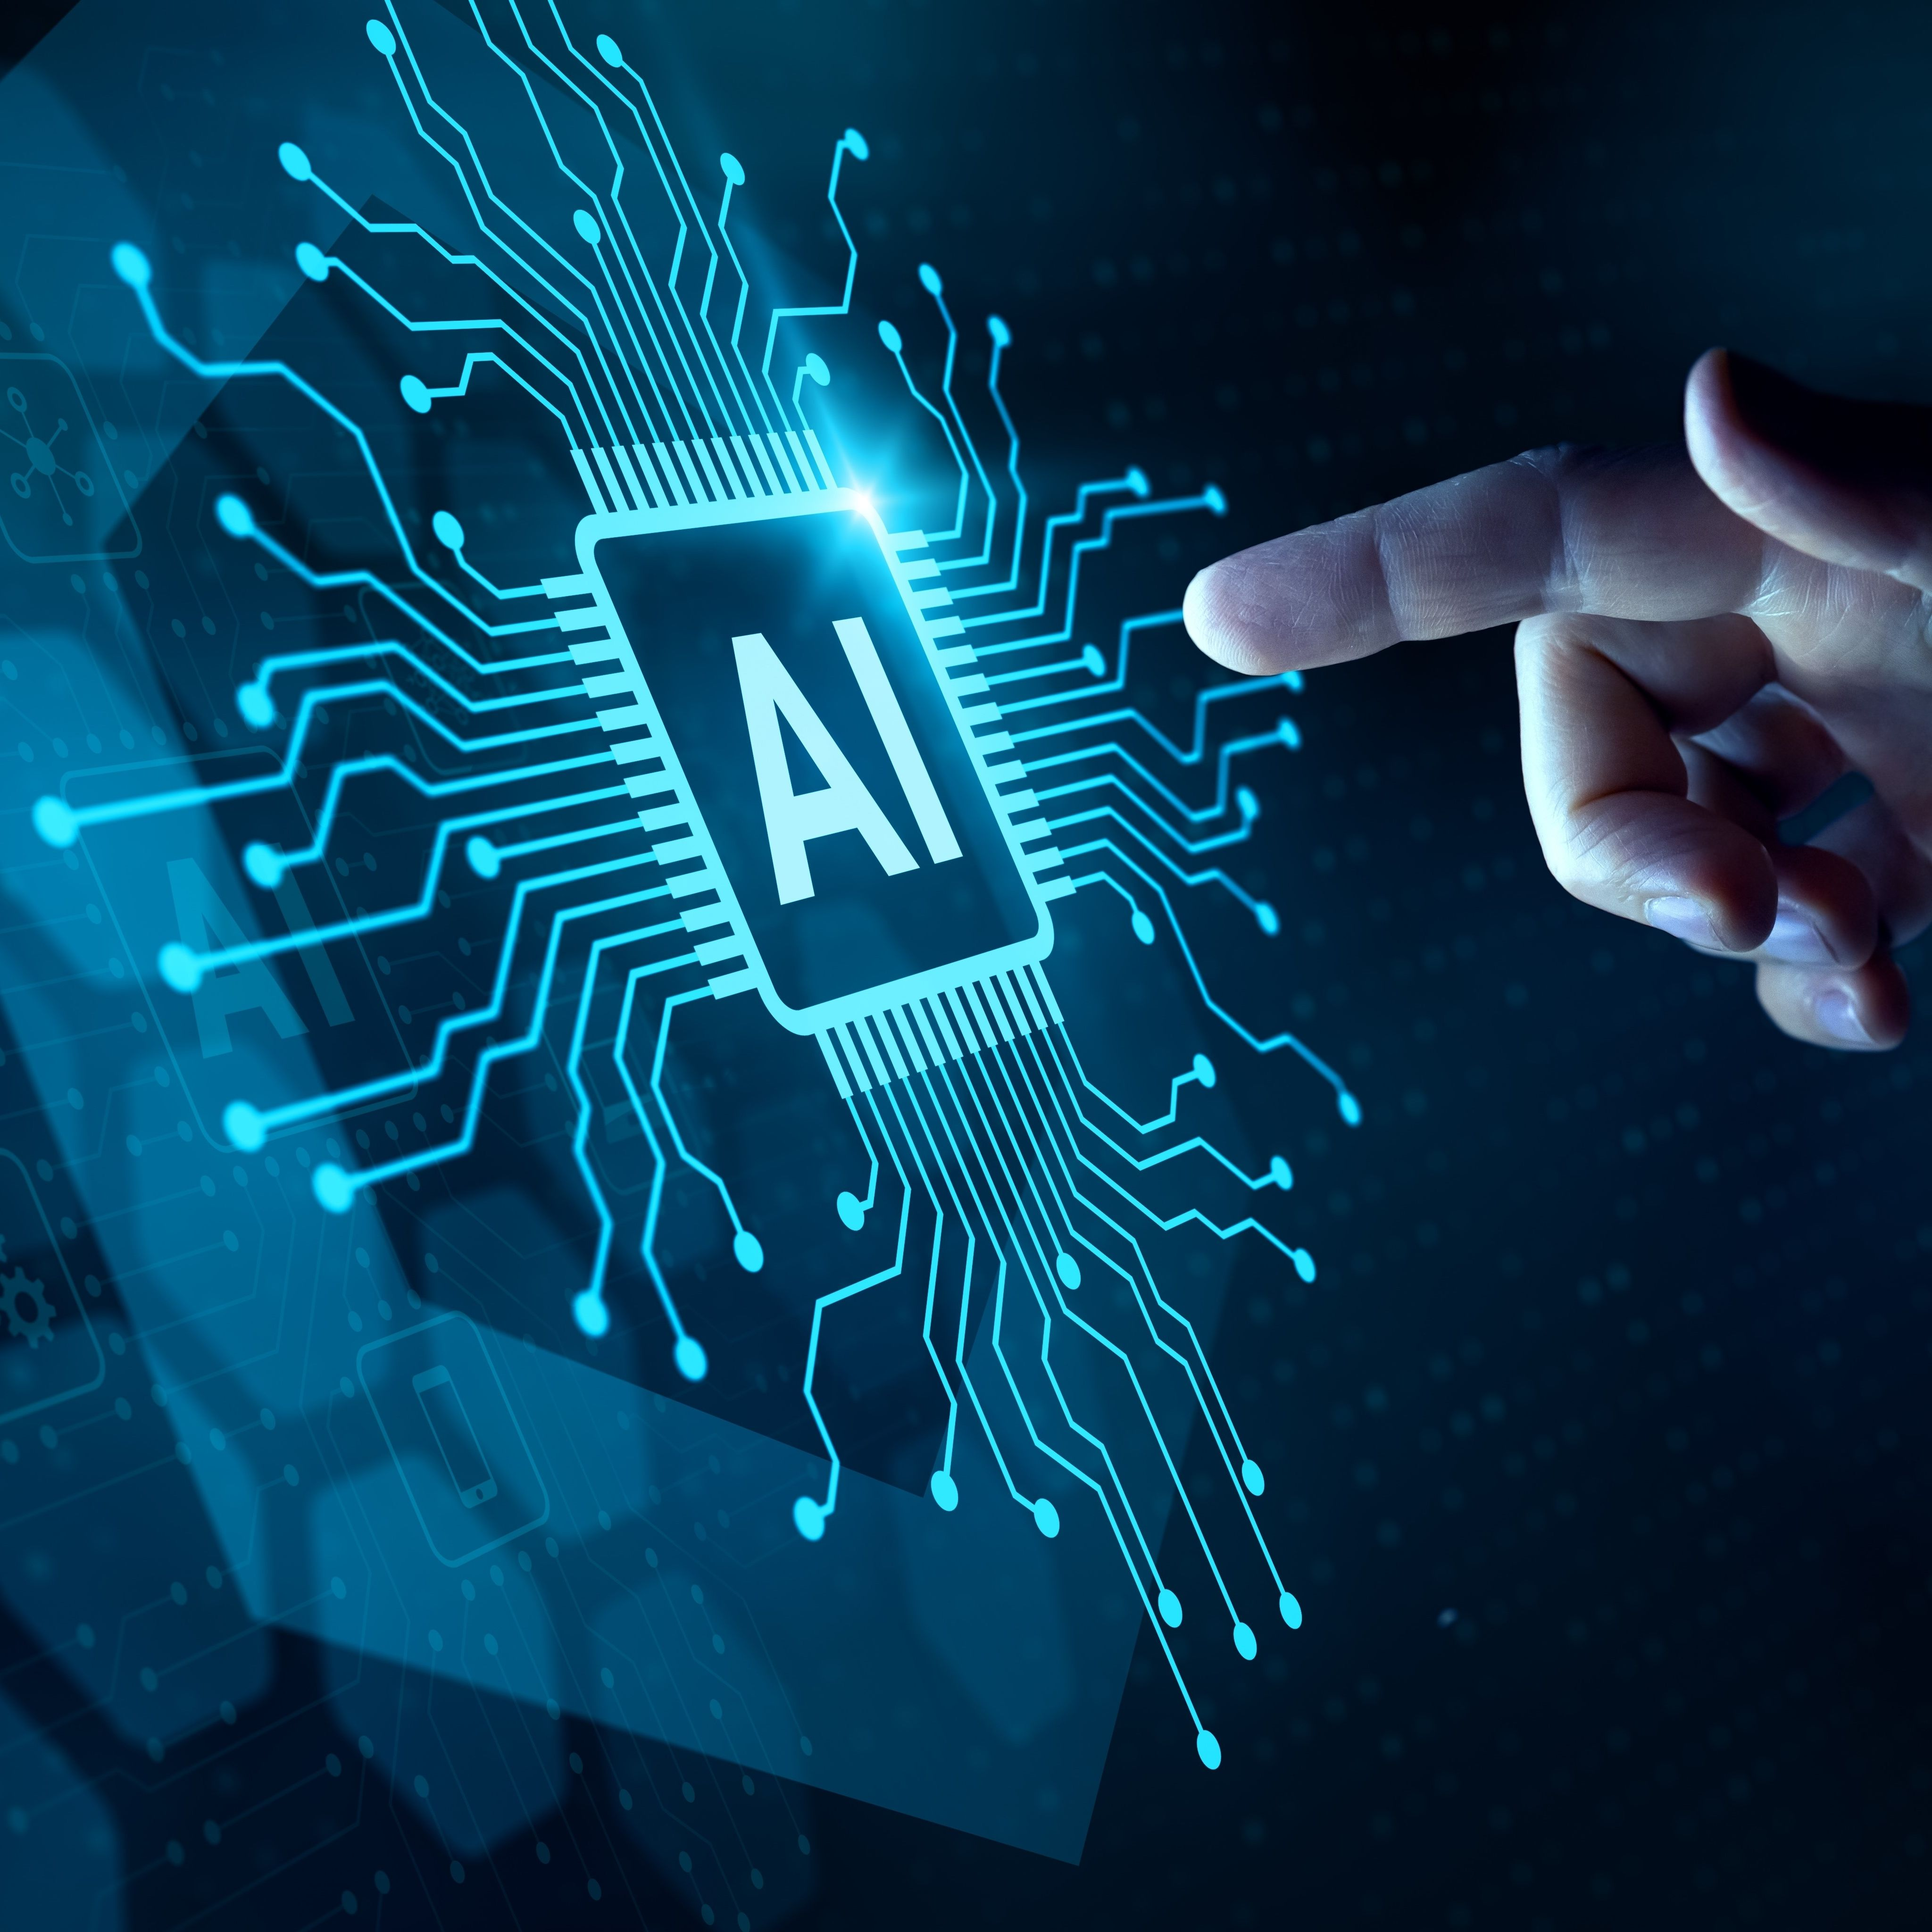
Conclusion
AI is transforming the way we live and work.
It presents both incredible opportunities and serious challenges.
Understanding AI is essential for the future workforce and society.

